Slide 1

H1B Application In-depth Analysis
Final Project - BUAD 5272
Chris Pickens, David Zheng, Stanley Yuan

Slide 2
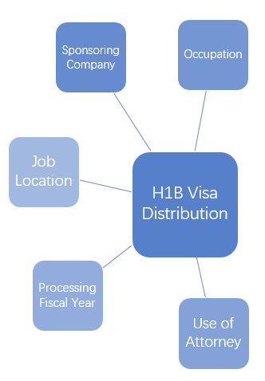
Objectives
To analyze H1B visa distribution on variables such as Sponsoring Company, Occupation, Job Location, Processing Fiscal Year and Use of Attorney

Slide 3
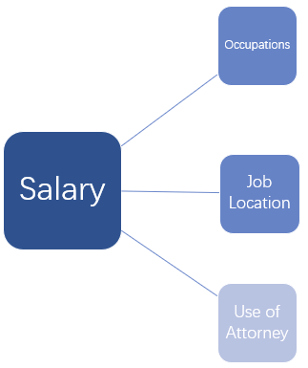
Objectives
Cross examinations of salary against Use of Attorney, Occupations and Job Locations
Notes:
Objective: To analyze H1B visa distribution on variables such as Sponsoring Company, Occupation, Job Location, Processing Fiscal Year and Use of Attorney. Additionally, cross examinations of salary against Use of Attorney, Occupations and Job Locations

Slide 4

Data
Data Source: Department of Labor, Office of Foreign Labor Certification Program
Data Used: OFLC Disclosure Data FY 2010, FY 2014 and FY 2018.
Selection Criterion -Covering time span of 2 presidencies and economic conditions
-Balancing data quantity, quality and efficiency

Slide 5
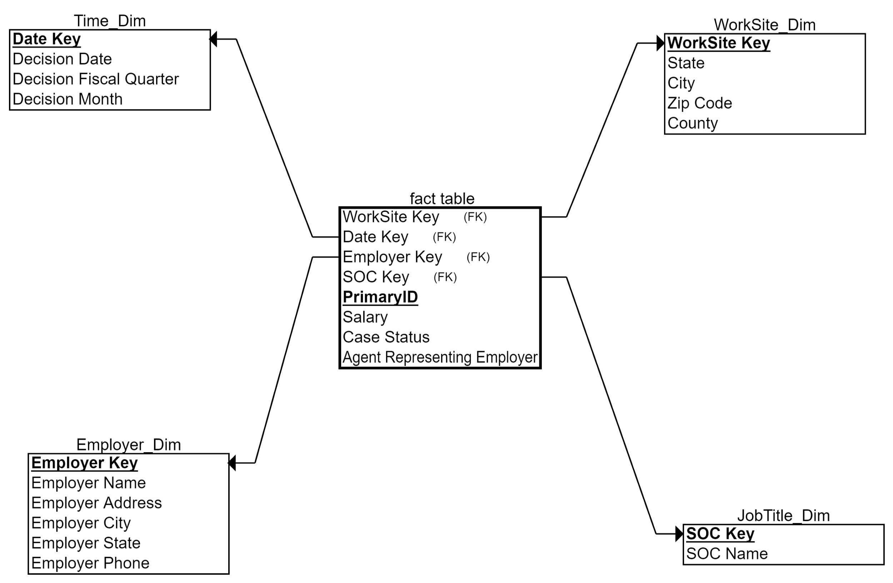
Dimensional Model Diagram

Slide 6
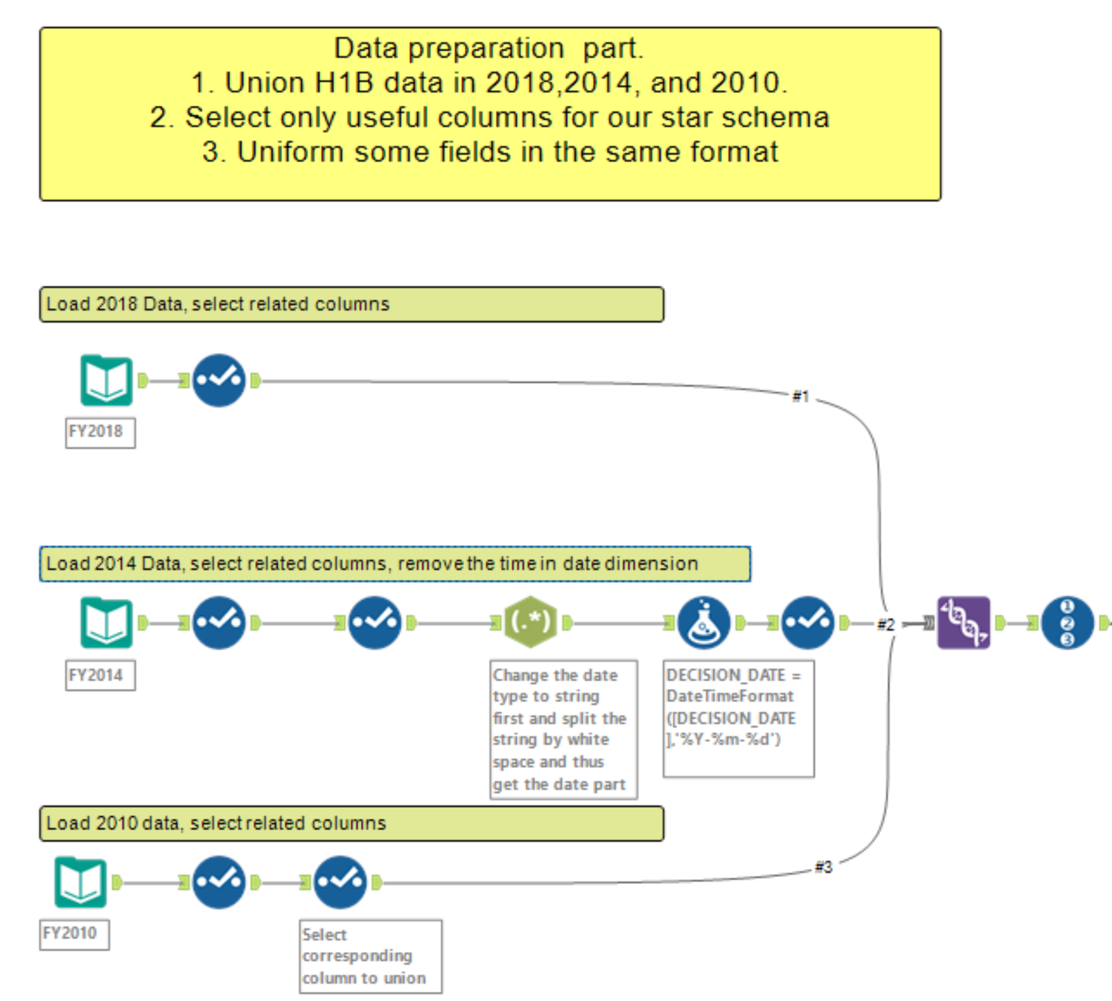
ETL Process--Database Preparation

Slide 7
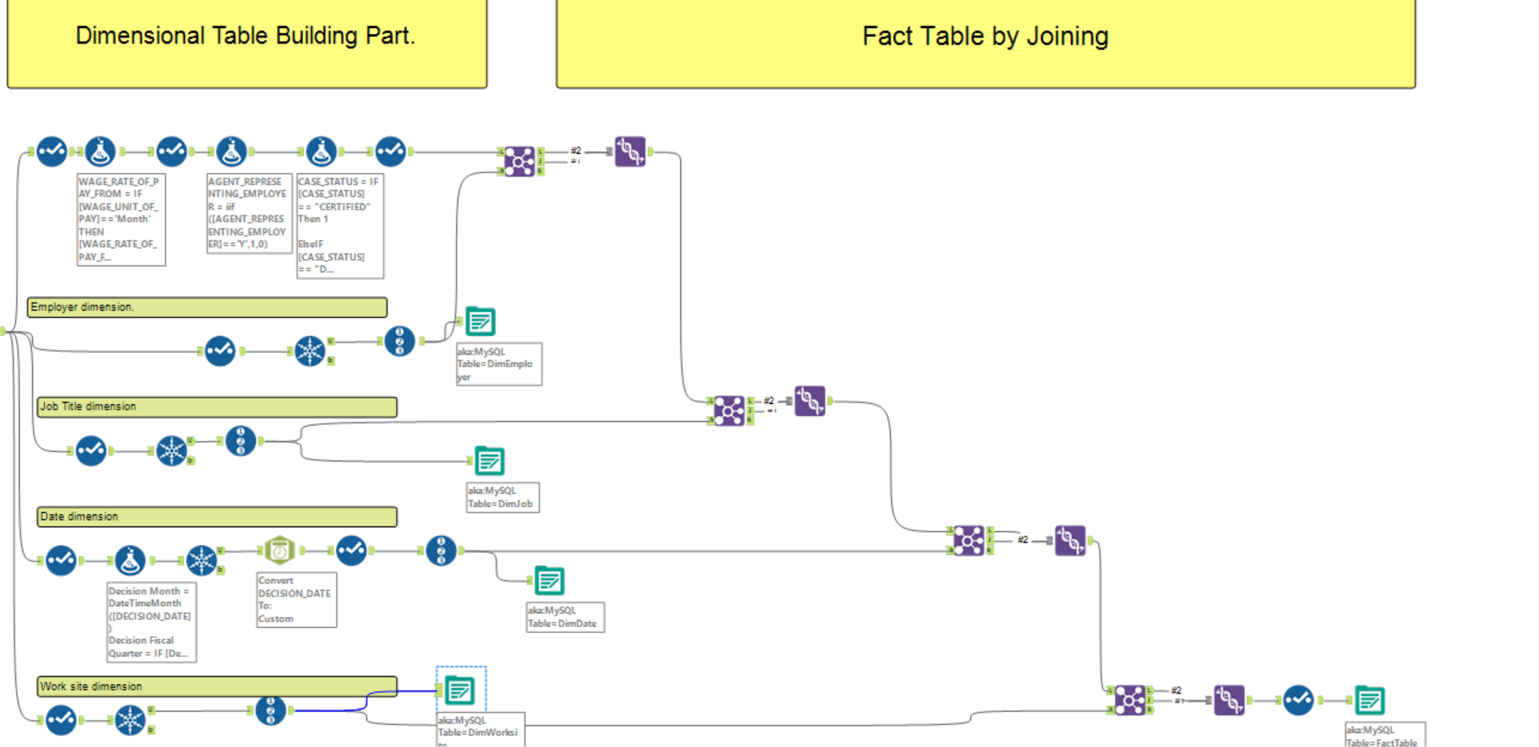
ETL Process--Dimension/Fact Table

Slide 8
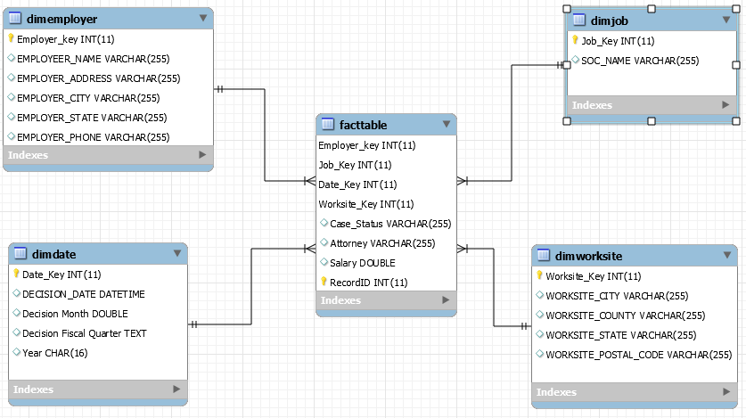
Final Schema from MySQL

Slide 9
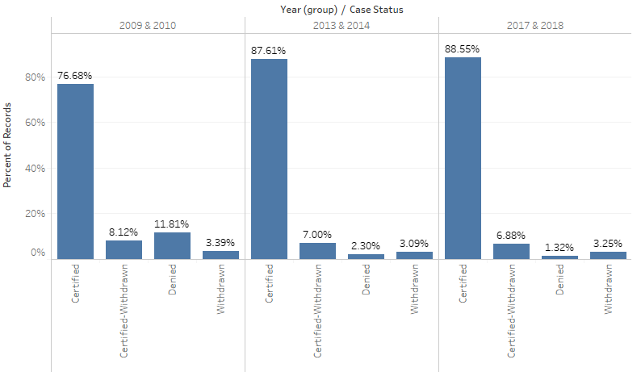
Case Status Over Time (2010,2014,2018)
Denials up in 2010
5x more than 2014
10x more than 2018
Recession?
Little change between 2014 and 2018
Political relationship is small

Slide 10
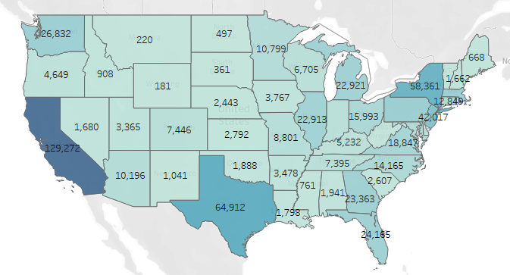

Where are Applicants Going? - 2018

Slide 11
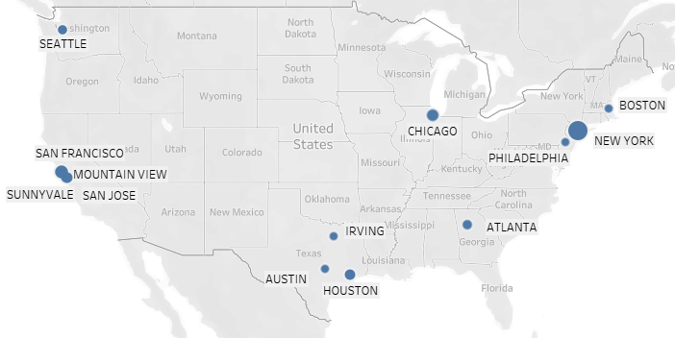
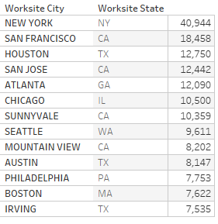
Where are Applicants Going? - 2018

Slide 12
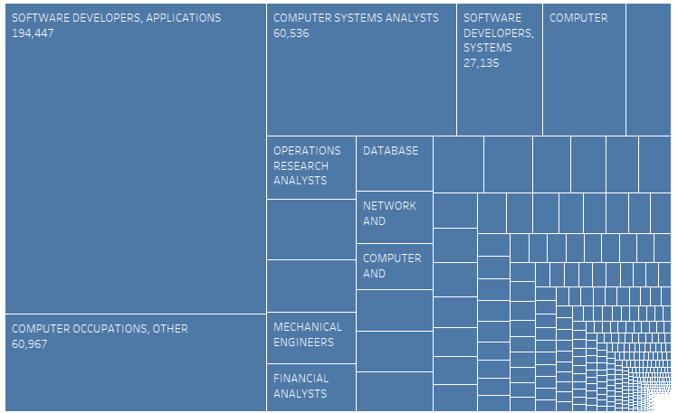
What are Applicants Being Hired For? - 2018
Lots of applicants from the tech sector
5 of top 9 jobs are in tech
Other major groups include finance, engineering, and medicine

Slide 13
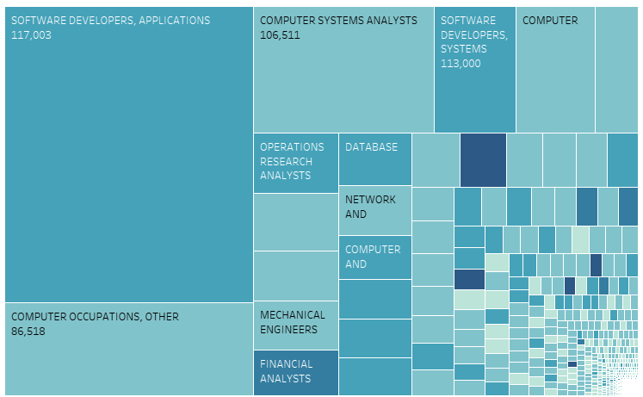

What are Applicants Being Hired For? - 2018
Fewer applicants for lower and higher paying jobs
6000 Surgeons
750 CEOs
500 Foreign Language Teachers
95 Healthcare Social Workers
Highest paid jobs are in medicine, lowest paid are in education and art

Slide 14
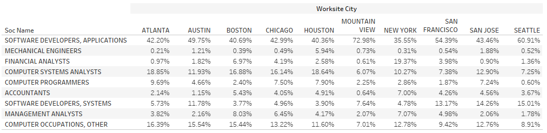
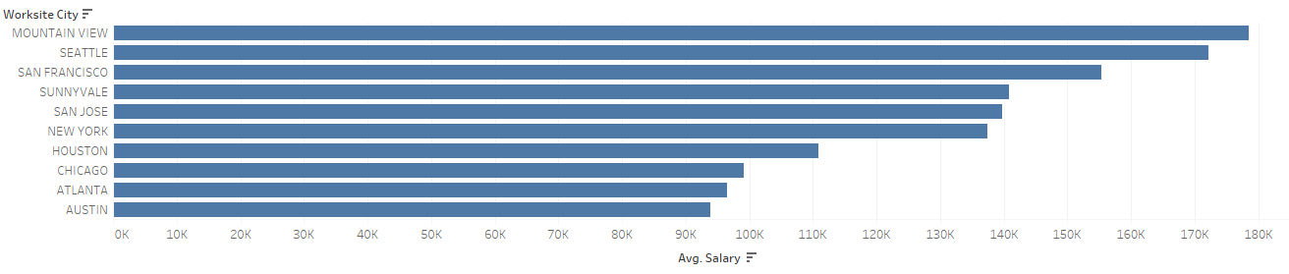
Job vs.City - 2018

Slide 15
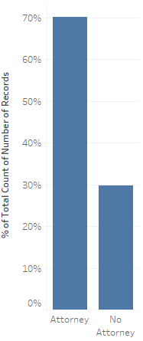

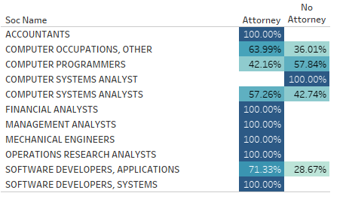
Attorney Effect - 2018
Most applicants have employer-hired attorneys
70% vs. 30%
Applicants with attorneys tend to have a higher salary
If an applicant’s salary is higher, company presumably would be more willing to pay for an attorney

Slide 16
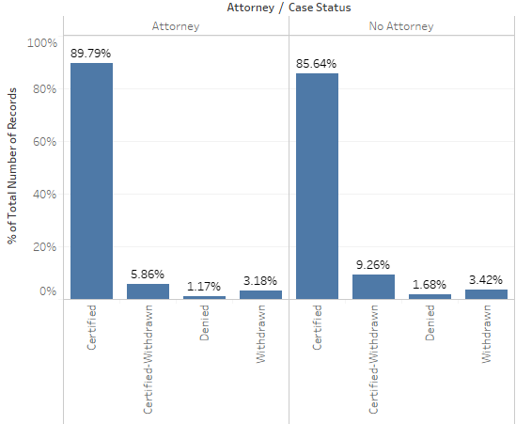
Attorney Effect - 2018
Effect of attorney seems mixed
Certified percent goes down but Certified-Withdrawn percent goes up
No noticeable effect on denial rate

Slide 17
Conclusion
Group’s experience with the project
Selection of source data
Inability to join the applicants’ data sources with other external sources (since all the applicants’ unique identifier are anonymized)
Instead of querying 1.6 million rows of data, we used random sampling to generate a 10% sample database for prototyping ETL structure. (time saving)
Technical troubleshooting
SQL server timeout issue
Duplicate entry for primary keys

Slide 18
Conclusion
Planning is important
Implementation is time consuming but not difficult
Learning about debugging seems valuable
Star Schema at the start
Came away with real insights
Fill out your stats course eval

Slide 19
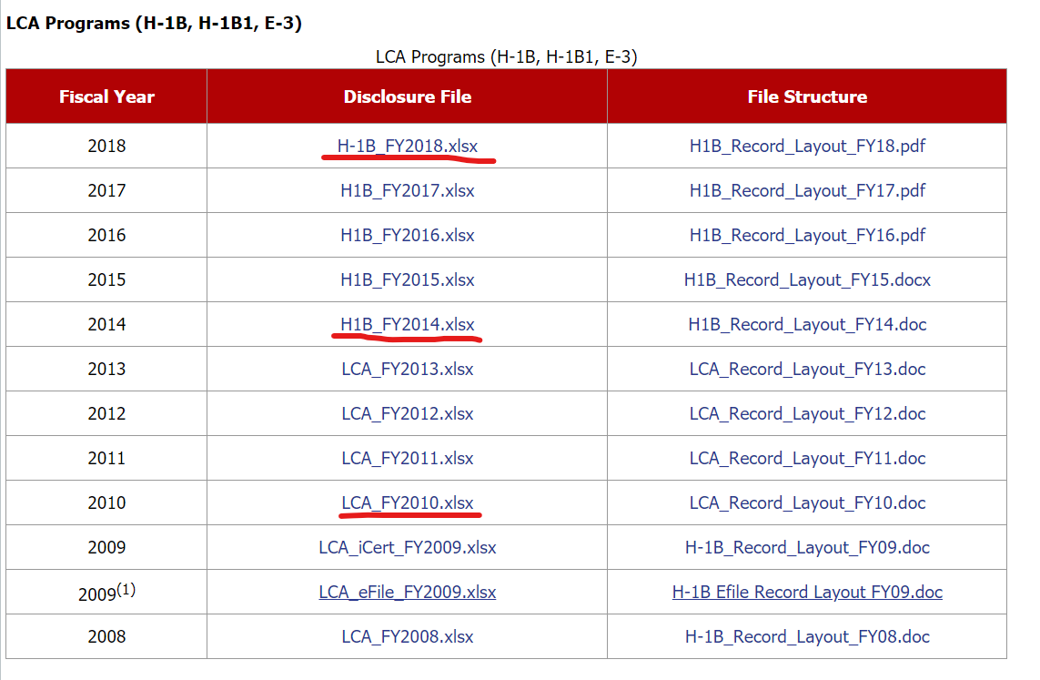
Dataset Used
https://www.foreignlaborcert.doleta.gov/performancedata.cfm
scroll to bottom third of the page shown as picture.
3 data sets:
H-1B FY 2018.xlsx
H-1B FY 2014.xlsx
LCA FY 2010.xlsx

Slide 20
MySQL Work Bench
https://drive.google.com/file/d/1yBrTMmBdKaYvsy3xw2GeTupoW83z-JN7/view?usp=sharing

